Slide 1

Flatiron Module 2 Project: Hypothesis Testing of Northwind Database

Slide 2

Hello!
My name is Kiarash Ahmadi. I’m an aspiring Data Scientist with Flatiron Academy. I am also pursuing a Master’s in Computational Science & Engineering at Georgia Tech. My field of work is in the building energy modeling industry.

Slide 3
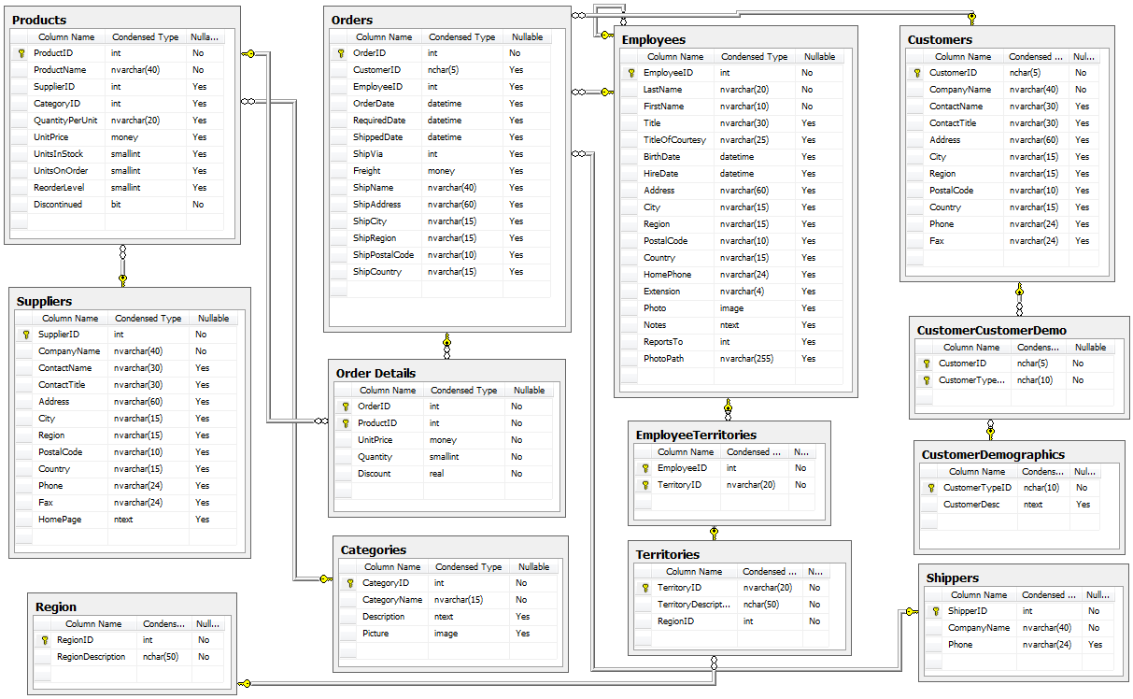
Project Background
Northwind is a fictional database made by Microsoft
Formulate questions that will be answered via hypothesis testing
Analysis of data is done beforehand to determine appropriate test

Slide 4
Questions to be answered
1. Does discount amount have a statistically significant effect on the quantity of a product in an order? If so, at what level(s) of discount??
2. Does customer region have a statistically significant effect on the quantity and/or price of a product in an order?
3. Does the shipping company have a significant difference on the total price of an order?
4. Do categories have a statistically significant effect on the price of products in an order?

Slide 5
Hypothesis Testing Process
Normality:
The normality of the samples in question are examined via distribution plot and a Kolmogorov-Smirnov test
Sample Size:
Different sample sizes create the need for a different test
Ex: Student’s T-test is for small samples
Variance:
Certain hypothesis tests assume that the samples in question are equal
One-Tailed vs. Two-Tailed:
Use one tailed if you want to assess the difference in one direction
Use two tailed if you want to assess the difference in either direction

Slide 6
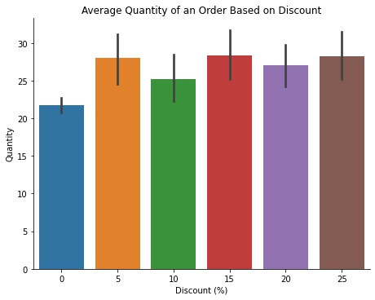
Does discount amount have a statistically significant effect on the quantity of a product in an order?
It was found that discounts do lead to a significant difference in quantity of a product order
More items should be discounted at 15% and 25% as it was found that these 2 discount groups have the largest effect
Welch T-test and ANOVA was used

Slide 7
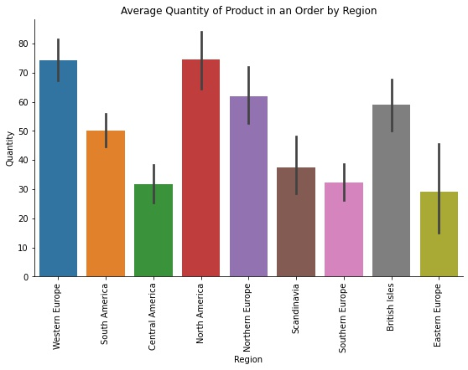
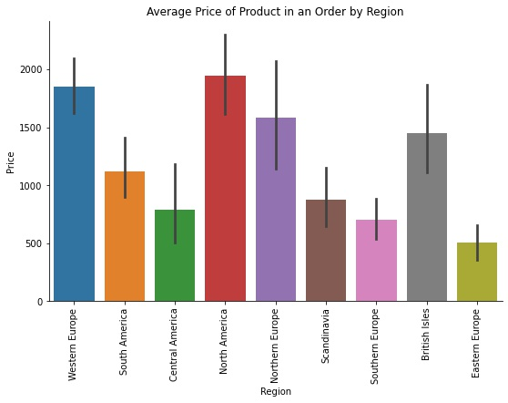
Does customer region have a statistically significant effect on the quantity and/or price of a product in an order?
Use of Welch T-test and ANOVA led to conclusion that region does have a statistically significant effect on both quantity and order
Thus, more focus can be put on regions where the average quantity and price in an order is lower:
Eastern Europe
Southern Europe
Scandinavia
Central America

Slide 8
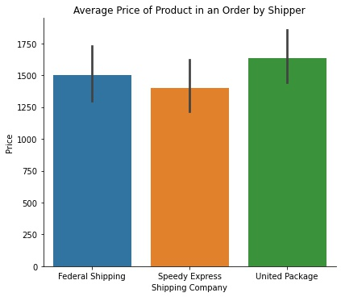
Does the shipping company have a significant difference on the total price of an order?
It was found that shipping company used in an order does not have a significant effect on the average price of an order,
Thus, no focus should be put on using one shipping company over the other
These results were gained using a Welch T-test

Slide 9
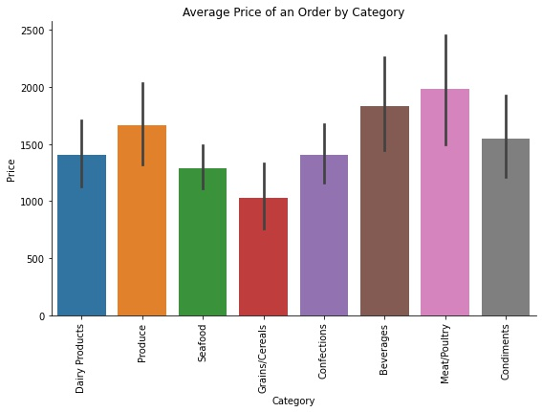
Do categories have a statistically significant effect on the price of products in an order?
Categories of products within an order have no significant effect on the average price of an order
Therefore, all categories should have equal focus as the use of ANOVA cannot prove that additional focus will lead to a statistically significant change in price of an order.

Slide 10

Recommendations
Discount
15% and 25% discount groups have the most impact on quantity ordered
Region
Focus on increasing average price in regions with lower prices and quantities ordered
Shipper
Shipping company has no statistically significant effect thus no focus should be put on one company over another
Category
All categories should have equal focus as the difference in prices was proven to not be statistically signficant
Future Work
Research Test Types
Research different tests outside of Flatiron curriculum that could be used to test hypotheses .
Resampling Methods
Perform resampling techniques on data to ensure same sample size among samples in question so that different hypothesis tests can be used.
Data Transformation
Transform the data in order to make it more normal. Would have to evaluate how this affects the interpretability of the results.
Notes:
2.31 quality
5.89 view

Slide 11

Thanks!
Any questions?
You can find me at:
mkiah09@gmail.com

